Slide 1

Employee Management System

Slide 2
Presented By: Taskeen Fatema
Employee Management System
In The Guidance Of:
Praisy Ma’am

Slide 3
Introduction
Employee management system is developed to maintain the details of employees in any organization.
It maintains the personal information/details of employees .
Employee management system has developed to override the problems prevailing in the practicing manual system.

Slide 4
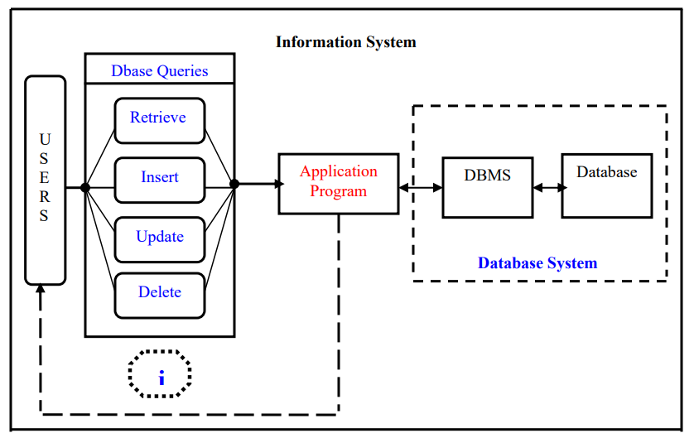

Modules :
Employee List
Create Employee
Update Employee
Delete Employee
View Employee
Employee Management System
MySQL

Slide 5
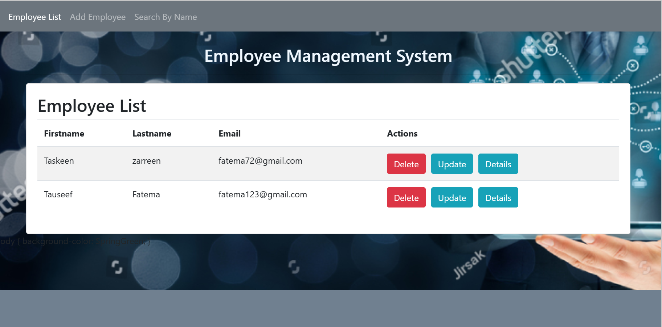
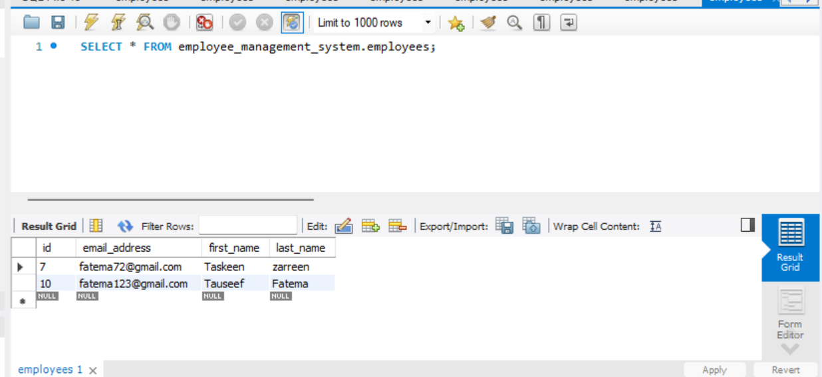
Employee List :
In the employee list module we can see whole employee list which is added.

Slide 6
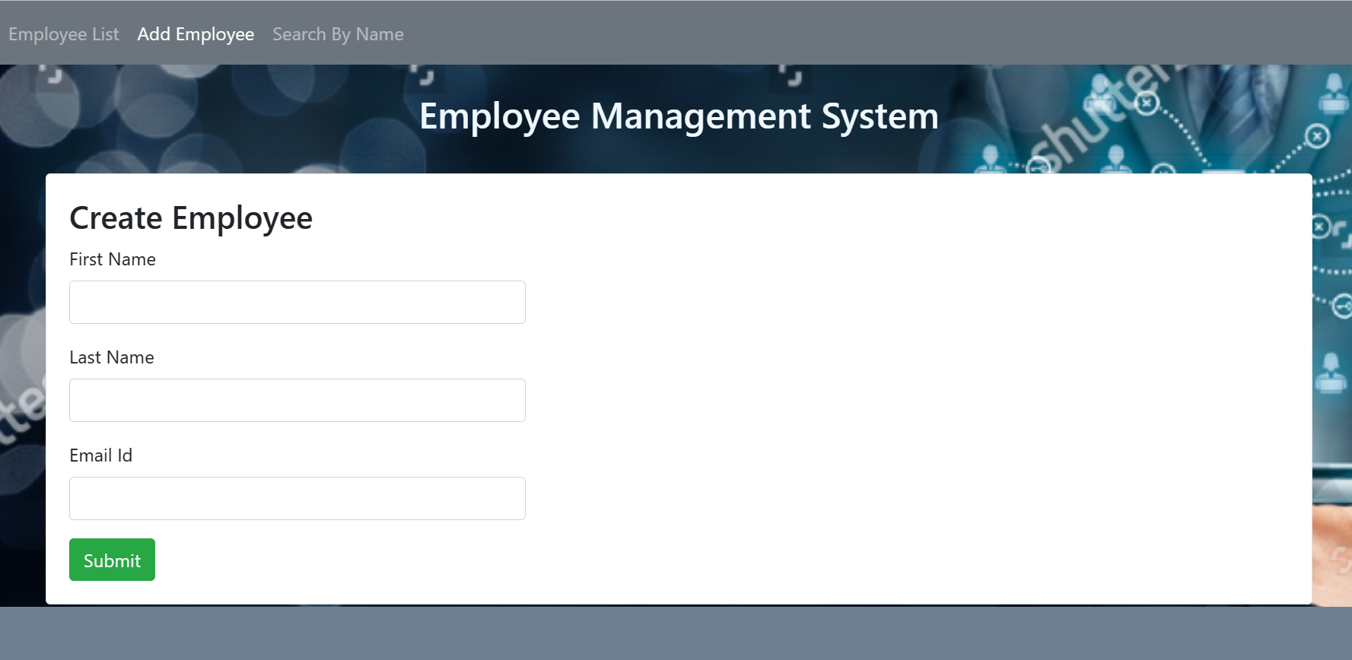
Create Employee :
Create employee module will add employee in the list and database.
We can add first name, last name and email address of employee.

Slide 7
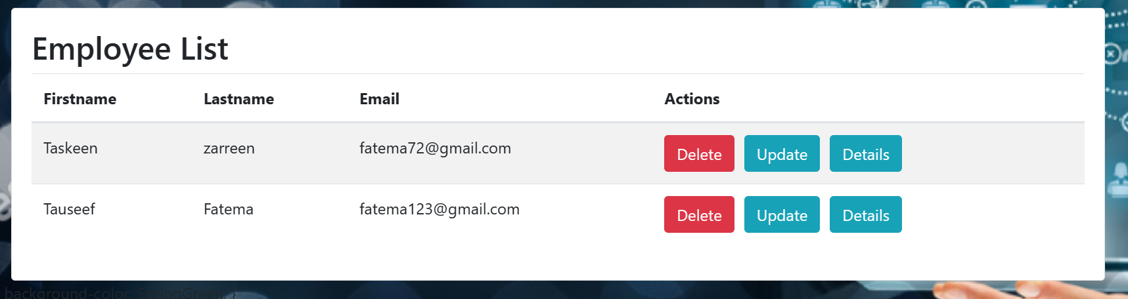
Update, Delete, View Employee :
Update will update the employee if user want any changes.
Delete module will delete the employee record from the employee and from database as well.
View will simply show the details of particular employee.

Slide 8
Hardware And Software Requirement :
Software Requirement:
Processor : i3
Primary Memory : 8.00 GB
Software Requirement:
Operating System : Windows 11
Frontend : HTML, CSS, and AngularJS
Backend : Spring Boot
Database : MySQL

Slide 9
THANK YOU

